Slide 1

April 11, 2018
Wifi: 1393Conference
Password: kayla1393

Slide 2

Important State Updates
NYSDOH Bureau of Social Determinants of Health Overview
May 24th Legislative Briefing with Senator Kemp Hannon
Feedback on the NYS Prevention Agenda
for 2019 – 2024
www.lihealthcollab.org

Slide 3
NYS Prevention Agenda and Community Health Improvement Initiatives
  Current cycle winding down
  Planning underway for next six-year cycle (2019 – 2024)
  Lots of Progress – visit the current dashboard
  Ad Hoc Committee to Lead the Prevention Agenda
  Collaborative process
  Input from all sectors sought (complete survey via https://www.surveymonkey.com/r/2018-feedback)
  Prevention Agenda Priorities reviewed and finalized by PHHPC

Slide 4
Prevention Agenda 2013-2018
Goal is improved health status of New Yorkers and reduction in health disparities through increased emphasis on prevention.
Call to action to broad range of stakeholders to collaborate at the community level to assess local health status and needs; identify local health priorities; and plan, implement and evaluate strategies for local health improvement.
Notes:
This slide summarizes the two major goals of the current Prevention Agenda for 2013-2018.
The first bullet refers to the overall goal of improving health status and reducing health disparities across the state by focusing on prevention.
The second bullet is a ‘call to action’ for local, collaborative needs assessments, identification of local health priorities, and taking action to address the priorities.

Slide 5
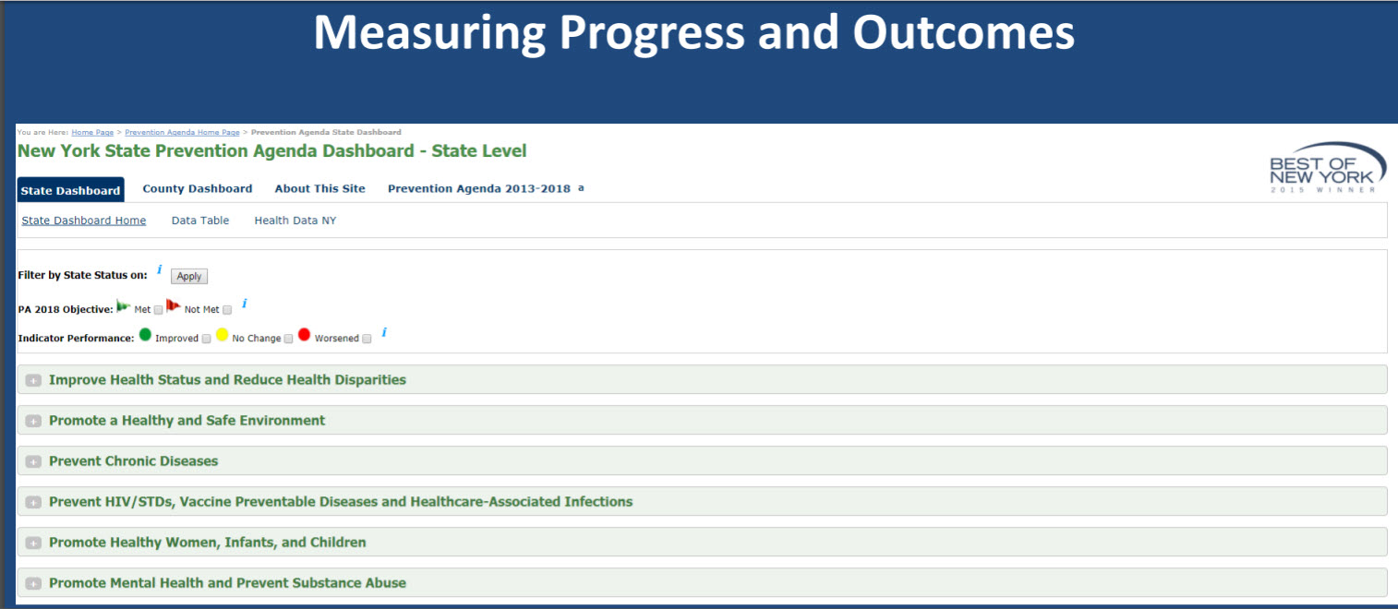
Prevention Agenda Dashboard

Slide 6
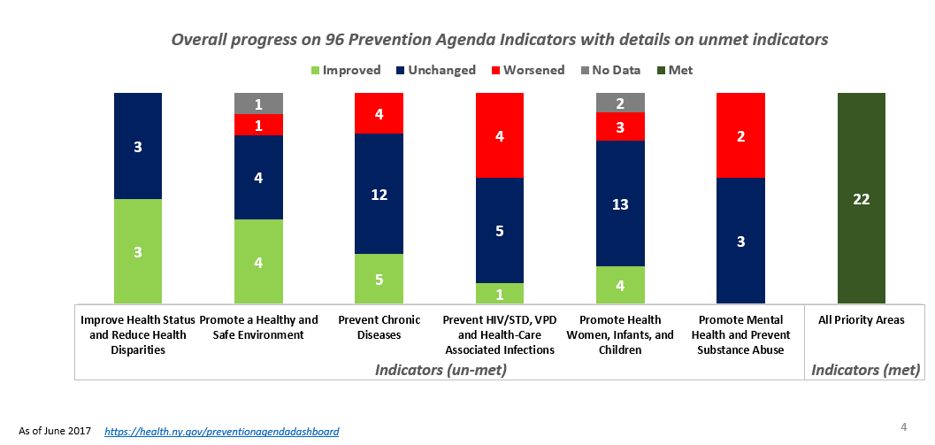
Prevention Agenda Dashboard Measures Progress on 96 Statewide Outcome Indicators, Including Reductions in Health Disparities
Notes:
This slide summarizes results shown in the Prevention Agenda Dashboard.
To track the state’s progress-to-date in achieving the objectives for the Prevention Agenda 2013-2018 plan, NYSDOH has been monitoring 96 statewide indicators for the five priority areas and one overall category to “Improve Health Status and Reduce Health Disparities,” shown here in the left-most bar.
As of June 2017, there were 22 indicators where the 2018 objectives were met. Some examples of these include: preventable hospitalization rate; assault-related hospitalization rate; heart attack hospitalization rate; newly diagnosed HIV case rate; teen pregnancy rate; and binge drinking rate among adults. Furthermore, the disparity in premature deaths between Hispanics and non-Hispanic Whites was significantly reduced.
Conditions such as obesity are linked to multiple determinants of health and, in many cases, reflect barriers to a healthy lifestyle caused by adverse social determinants of health. For these reasons, we don’t expect all these indicators to improve overnight, but of the 71 indicators with data that have not been met, 12 are significantly improving, with moderate improvement in 5 others.
Much more needs to be done, however, because 40 of the 71 indicators have stayed the same and 14 are going in the wrong direction. For additional information on progress in each priority area see:

Slide 7
Updating the Prevention Agenda for 2019-2024
2018 NYS Health Assessment:
  Changes in NYS demographics and health status since 2012
  Progress to date on Prevention Agenda objectives, using Prevention Agenda dashboard
Considerations for how to address what influences health, including the social determinants of health, healthy aging and how to make better progress in addressing racial and ethnic disparities and socio-economic status
  Emphasizing healthy aging across the life cycle in each priority area
  Incorporating a health-across-all-policies approach including upstream, “non-health” interventions and strategies in each priority area
Considerations for how to strengthen local action including strength and diversity of local collaboration, across health and non-health agencies, between state and local agencies, among counties, cities and towns, and between public and private organizations
  Implementation of evidence based interventions, and regular assessment of local progress
Feedback on proposed Focus Areas and Goals
Notes:
This presentation describes four elements that will inform the update of the current Prevention Agenda. The Ad Hoc Committee is seeking your feedback.

Slide 8
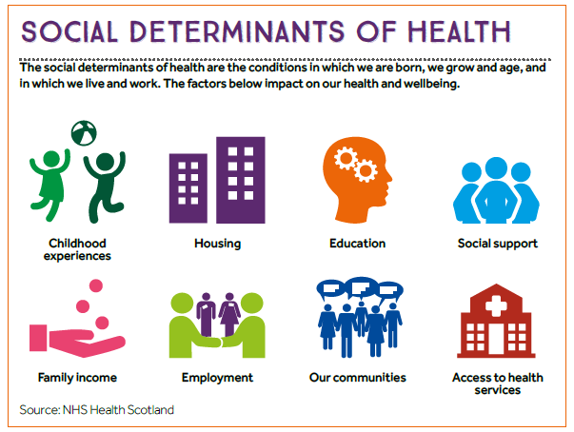
Notes:
The social determinants of health are the conditions in which we are born, grow and age, and in which we live and work including our communities, the housing we live in, the schools we attend, our access to social support, our socio-economic status, as well as our access to health services.
As shown on the earlier slide from County Health Rankings, 80% of health outcomes are attributable to these social determinants of health. To be successful in the Prevention Agenda, we need to identify and implement interventions that can impact these determinants.

Slide 9
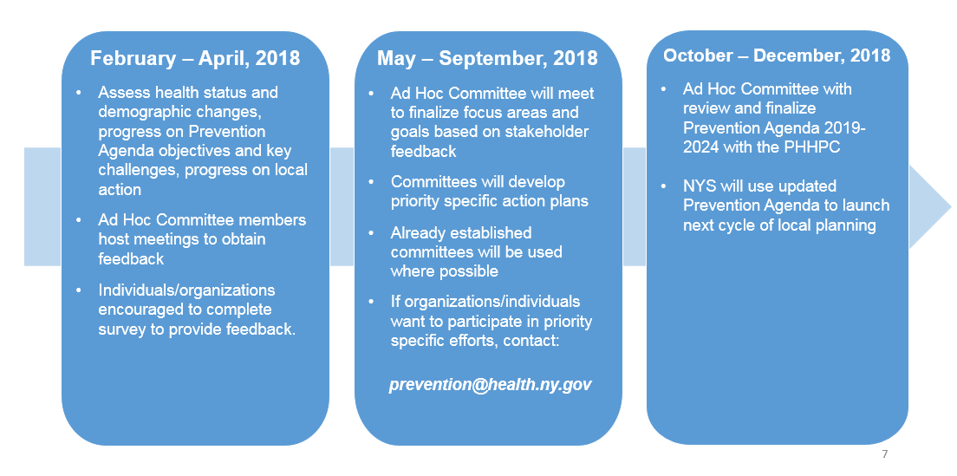
Timeline for Updating the Prevention Agenda for 2019-2024
Notes:
The timeline for the update is shown on this slide. There are many opportunities to participate in the development of this plan.
Between the end of February and April, Ad Hoc Committee members have been asked to host meetings with their individual member organizations to get their feedback.
A survey to solicit feedback can be completed by anyone who wishes to provide input – see the link:
Once the priorities and focus areas have been finalized based on the feedback, committees will meet this summer to develop priority-specific plans.
Where possible, we will use existing committees to develop the plans. For example, the Maternal and Child Health Block Grant Advisory Committee will develop the plan for Promoting Healthy Women, Infants and Children.
If you want to participate in drafting priority-specific plans, please send an email to prevention@health.ny.gov to indicate your interest.

Slide 10
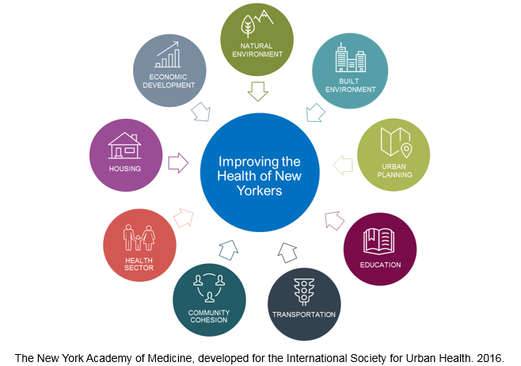
Health Across All Policies:
A multi-sectoral approach to improving health
Notes:
Another approach that is equally important is to focus on actions by government agencies and the private sector – beyond the traditional health sector – that are critical to addressing the social determinants of health. This has been a major focus of the LIHC and is one of the reasons we have such a diverse partnership.
Governor Cuomo has made a commitment to implementing a Health-Across-All-Policies approach, which includes public polices across sectors that systematically takes into account the health and health system implications of decisions, seeks synergies, and avoids harmful health impacts in order to improve population health and health equity.
The Health-Across-all-Policies approach emphasizes the consequences of public policies on health determinants and aims to improve the accountability of policy-makers for health impacts at all levels of policy-making.
In the updated Prevention Agenda we are increasing our emphasis on partnering with government and non-government agencies to help us adopt this approach.

Slide 11
Priority Comparison
2013 – 2018 (Current)
Prevent Chronic Diseases
Promote a Healthy and Safe Environment
Promote Healthy Women Infants and Children
Prevent HIV/STDs, Vaccine-Preventable Diseases, and Healthcare-Associated Infections
Promote Healthy Women, Infants, and Children
Promote Mental Health and Prevent Substance Abuse
2019 – 2024 (Proposed)
Prevent Chronic Diseases
Promote a Healthy and Safe Environment
Promote Healthy Women Infants and Children
Prevent HIV/STDs, Vaccine-Preventable Diseases and Antimicrobial Resistance, and Healthcare-Associated Infections
Promote Well Being and Prevent Mental and Substance Use Disorders

Slide 12
Proposed Focus Areas and Goals
Notes:
For each Priority, NYS Department of Health, Office of Mental Health and Office of Alcohol and Substance Abuse Services have proposed updated focus areas and goals for consideration, shown on the next five slides.

Slide 13
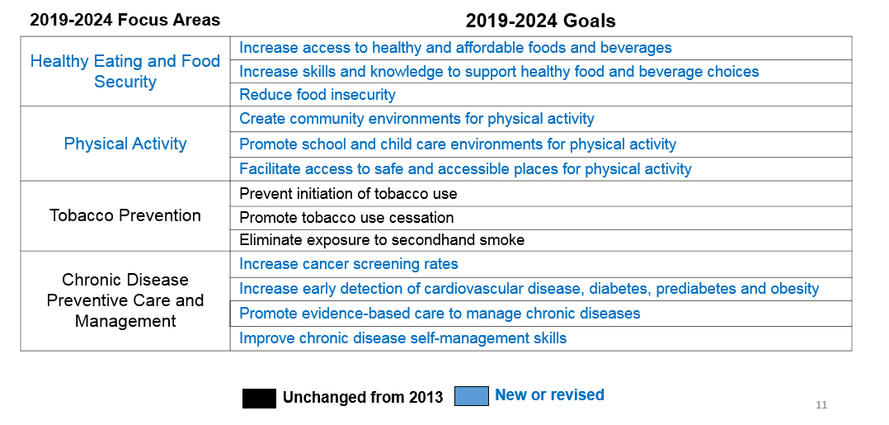
Prevent Chronic Diseases
Notes:
The focus areas of this priority have been updated to separate out healthy eating and food security and physical activity where as before there was one focus area on obesity.
Goals have been updated to feature key areas for intervention.

Slide 14
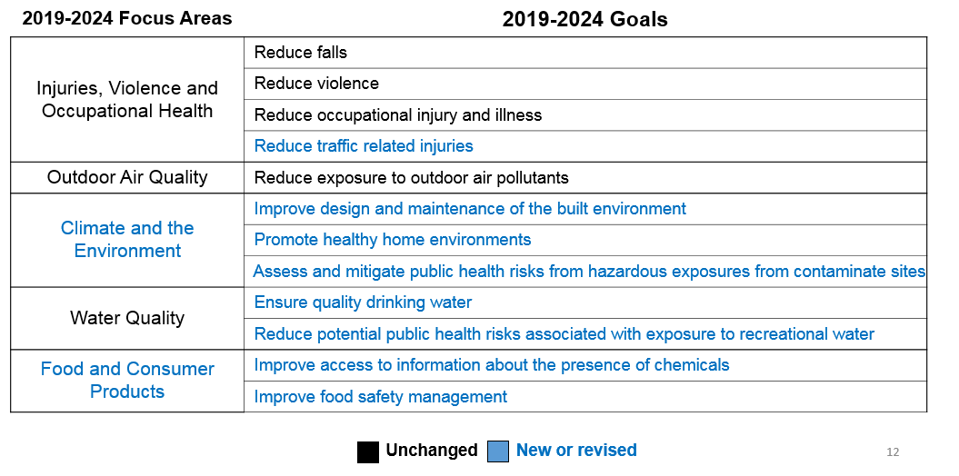
Promote a Healthy and Safe Environment
Notes:
This priority includes a new focus area related to food and consumer products and updates the climate and environment focus area.
There are new goals related to water quality to focus attention on some of the current challenges.

Slide 15
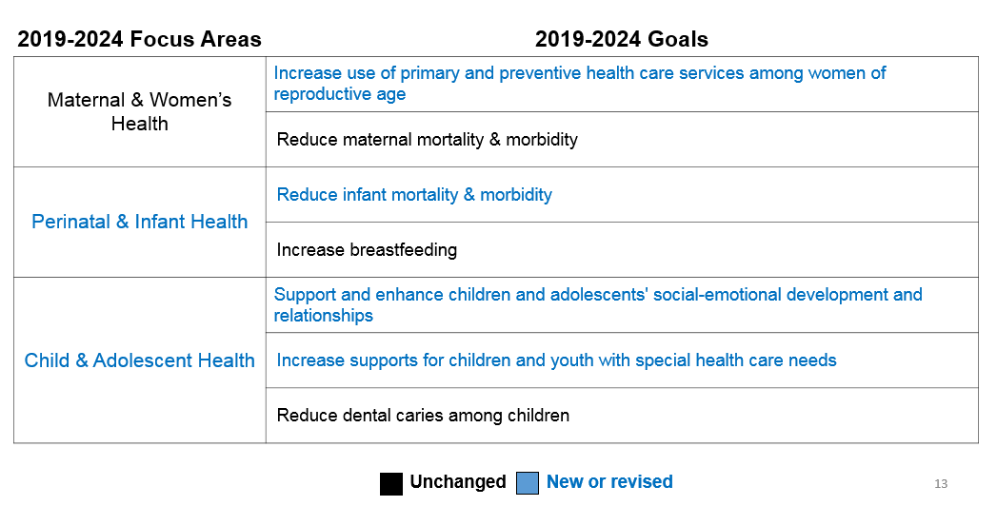
Promote Healthy Women, Infants, and Children
Notes:
This priority’s focus areas and goals have been updated to align with the state’s Title V Maternal and Child Health Block Grant plan, and to increase support on the health of women.

Slide 16
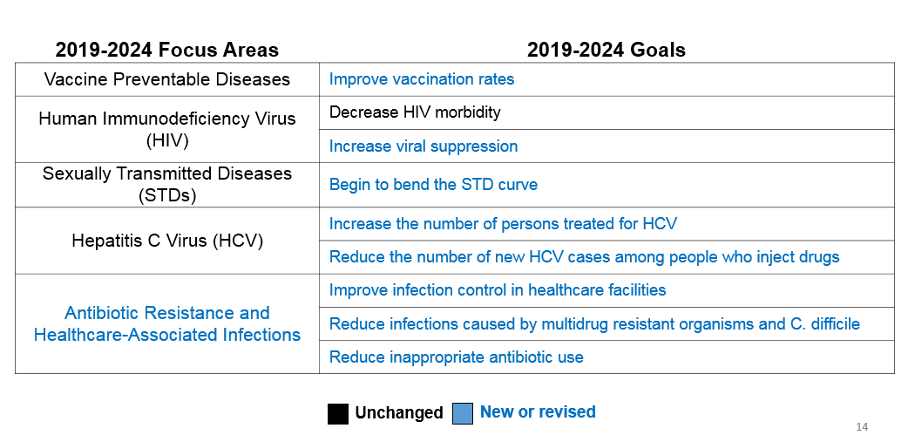
Prevent HIV/STDs, Vaccine-Preventable Diseases and Antimicrobial Resistance, and Healthcare-Associated Infections
Notes:
This priority area is focused on preventing infections, prioritizing attention on reducing vaccine-preventable diseases, HIV and STDs, Hepatitis C Virus, as well as antimicrobial resistance and healthcare-associated infections.

Slide 17
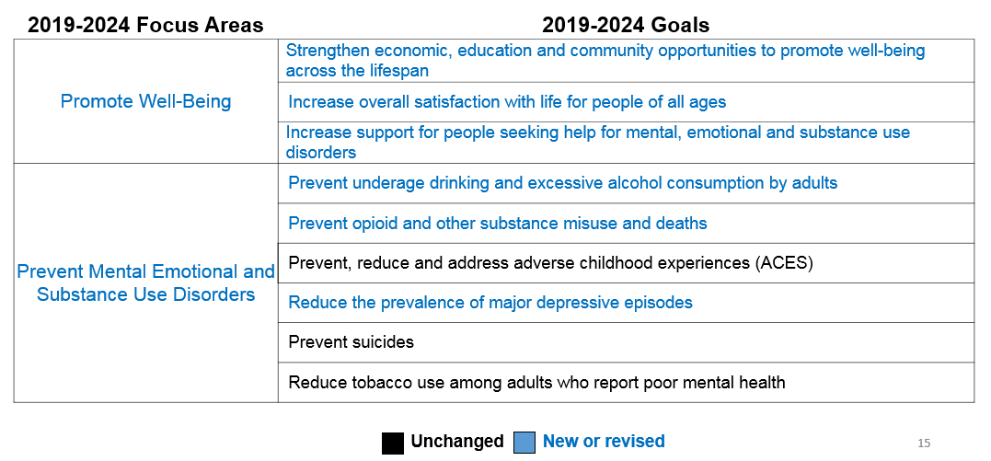
Promote Well Being and
Prevent Mental and Substance Use Disorders
Notes:
This priority has a new title, focuses attention on well being, and a new focus on prevention of substance use disorders.
The focus area related to strengthening infrastructure has been removed. New York State supports the goal of strengthening infrastructure, but wants that effort to be linked to one of the specific goal areas listed here.

Slide 18
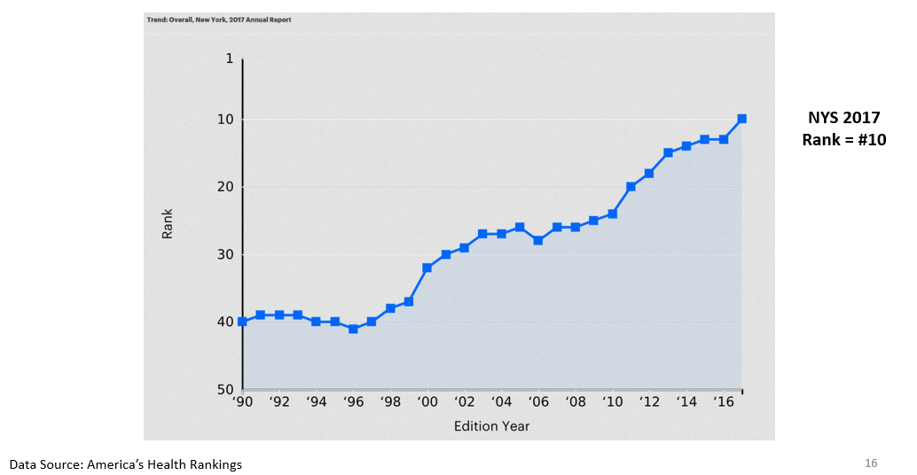
New York State Overall Ranking, America’s Health Rankings
Notes:
A bit of good news for everyone’s collective efforts. But we know more work needs to be done.
The health status of New Yorkers – as measured by the America’s Health Rankings – has greatly improved.
For nearly 3 decades, America’s Health Rankings has provided an annual summary of the nation’s health on a state-by-state basis by analyzing a comprehensive set of health, environmental and socioeconomic data to determine national health benchmarks and state rankings.
New York State’s rank has improved drastically in the last two decades. We are currently ranked 10th in the nation, up from 40th in 1990 and 26th in 2008, when the Prevention Agenda began.

Slide 19
NYS Health Assessment 2018 - Summary
The NYS population is aging and becoming more diverse.
Chronic disease continues to be a major burden including heart diseases, cancers, diabetes, and asthma.
We are making good progress in some maternal and infant health indicators including teen pregnancy and breastfeeding but more work to be done to address the disparities related to infant mortality, preterm birth, and maternal mortality.
We are on the path to end AIDS but have challenges reducing STDs as well as Hep C.
In the past several years, water quality has become a major issue that warrants attention.
Most importantly we have identified opioid overdose as a major issue that is contributing to declining life expectancy.
Notes:
But challenges remain. The health assessment compiled by the New York State Department of Health indicates that our state still faces challenges in each of the five Prevention Agenda priority areas, as summarized here.

Slide 20
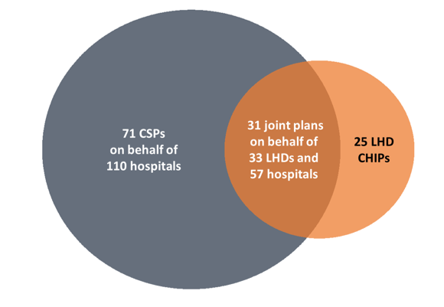
2016-2018 Collaborative
Health Improvement Plans
127 plans
by 58 LHDs
and 167 Hospitals
Notes:
The New York State Prevention Agenda calls on local health departments and hospitals to collaborate with their community partners on the development of community health assessments and community service plans.
In addition to requiring collaboration, New York State requires that communities develop comprehensive plans that outline what organizations will do in the next three years to identify and address health challenges in their community.
While there was some collaboration early on, New York State has made great progress – to the point that more than half of the counties developed joint plans. In the communities where separate plans were provided, there was also strong evidence of collaboration.

Slide 21
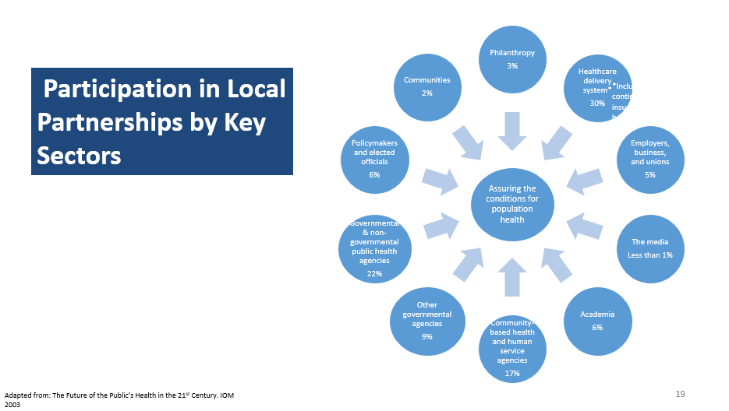
Notes:
New York State has also seen improvement in cross-sector collaboration. This diagram shows the kinds of organizations and percentages participating in partnerships to reduce chronic diseases. Local health departments and hospitals collaborated most often with other healthcare organizations, governmental and non-governmental public health agencies and organizations, and community-based health and human service organizations. Some important partner types are still missing from our cross-sector collaborations. That is one of the challenges the state is asking us to help them address.

Slide 22
LIHC as Coordinating Entity
Since 2013, the LIHC has worked with diverse partners
Two CHNAs – 2013 and 2016
Chronic disease rose to top in both CHNAs
CHNA results drove selection of PA priority – Reduce Chronic Diseases
  Two Focus areas:
    reduce obesity
    increase access to chronic disease self-management program
    Prevention/treatment related to mental health and substance use issues interwoven into partners’ work
www.lihealthcollab.org

Slide 23
Please Weigh In
State wants input from diverse stakeholders
Opportunity to inform the next PA cycle
Hospitals, county health departments and their many CBO partners – work is directed by the PA
Please complete the brief survey by April 25, 2018
www.surveymonkey.com/r/2018-feedback
Be sure your voice and the needs of those you serve are heard
Questions?
You will receive an email with this link.
www.lihealthcollab.org

Slide 24
Updates
Food Access Cluster
Data Advisory
Physical Activity Cluster
LGBTQ Consortium
www.lihealthcollab.org

Slide 25

Networking & Stretch Break
www.lihealthcollab.org

Slide 26
Quarterly Data Report
First in a series of quarterly report examining trends and patterns of selected health topics
Q1: Physical Activity in Adults – a Look into the Long Island Region
www.lihealthcollab.org

Slide 27
Networking Events
Fall of 2018
Nassau and Suffolk Events
“Bingo for Business”
Location ideas?
www.lihealthcollab.org

Slide 28

Suffolk Care Collaborative
Amanda Chirco, M.Ed
Project Manager, Community Health Initiatives
Amanda.Chirco@stonybrookmedicine.edu
www.lihealthcollab.org

Slide 29
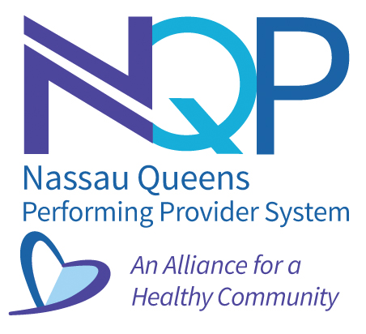
Nassau Queens PPS
Anu Anish
DSRIP Project Coordinator
aanish@nqpps.org
www.lihealthcollab.org

Slide 30
  Long Island Health Collaborative
  April 11, 2018

Slide 31

CBO INNOVATION FUND
Created with the goal of contracting with 33 Tier 1 CBOs (non-Medicaid billing). In order to:
  Build relationships
  Gain knowledge of the needs of the communities and organizations that serve them
  Explore opportunities to align efforts

Slide 32



Tier 1 CB0s
Hub/Organization | Number Contracted
 | 1
 | 9
 | 23
PPS TOTAL | 33

Slide 33

Hubs Contracted CBOs
Adelphi University Breast Cancer Program
Chinese-American Planning Council of Queens
God’s Love We Deliver
The INN
Island Harvest
Long Island Alzheimer’s Foundation
Long Island Cares
Long Island Greenmarket
NAMI
YMCA

Slide 34

NQP Contracted CBOs
EMG Health Communications, Inc.
First Jamaica Community and Urban Development Corporation
Friends of the Glen Cove Youth Board, Inc.
Gateway Youth Outreach
Glory House Recovery, Inc.
Haitian American Family of Long Island, Inc.
Hempstead Hispanic Civic Association
Hispanic Brotherhood
LICADD
Long Island Coalition for the Homeless
Long Island Hispanic Pastoral Association/New Covenant Church
Make the Road New York
Mental Health Association in NYS, Inc.
New York Association of Psychiatric Rehabilitation Services, Inc.
New York Race Track Chaplaincy
Ocean Bay Community Development Corporation
Peace Valley Haven, Inc.
Queens Library Foundation, Inc.
Rockaway Waterfront Alliance
Rockaway Youth Task Force
Uniondale Community Council, Inc.
United Veteran Beacon House
Venture House

Slide 35

Phase 1 & 2
The CBO Innovation Fund is comprised of two phases:
Phase 1 :
  CBOs are required to hold a Health Forum that aligns with DSRIP efforts and their community needs
  CBOs are required to submit monthly referral trackers
  CBOs are required to take a series of trainings, such as CCHL and VBP.
  CBOs that perform well during Phase 1 are then considered for Phase 2.
Phase 2:
  Basic contracts will be renewed and a smaller subset of high performing CBOs will receive larger grants

Slide 36

Health Forums
Contracted CBOs are required to hold a minimum of one health forum.
    These forums help identify CBOs reach within the community.
    Health Forum should be catered to the needs of the specific community.
NQP distributes Community Needs Assessment Survey to forum attendees.

Slide 37

Community Needs Assessment Survey
Administration of the Surveys
Feedback
Analysis
Obstacles

Slide 38
Innovation Fund Timeline
April 2018
Evaluate contractors to determine:
July 2018
March 2018
February 2018
Reporting
Community Forum/Health Literacy Event development and execution
Planning Innovation Fund conference with CBOs and Hubs/Healthcare Providers
Candidates for general renewal
Develop Phase 2 projects with selected organizations focused on Social Determinant of Health intervention related to VBP
Candidates for Phase 2 projects
May 2018
Host CBO Conference

Slide 39
NQP WEBSITE
http://www.nqpps.org
Project Information
Project Resources
  HWApps Training Portal
News & Events
Career

Slide 40
Research Study Opportunity
Federally funded stress study by Stony Brook University
Looking for “astronaut-like” participants – individuals with advanced degrees in STEM fields
www.lihealthcollab.org

Slide 41
Feedback + Adjournment
Next meeting, June 13, 2018
To register, visit
lihcjune2018.eventbrite.com
www.lihealthcollab.org

